Slide 1

Gateway overview and operation
Kai Droste
Notes:
Entwicklung einer Cloud basierten Gebäudeautomation und Vergleich dieser zum aktuellen Stand der Technik
Es wird geschätzt, dass die Nutzung des IoT bis 2025 auf über 80% anwachsen und zu einem potenziellen globalen wirtschaftlichen Aufschwung führen wird
[H. Uddin; M. Gibson; G. A. Safdar; T. Kalsoom; N. Ramzan; M. Ur-Rehman; M. A. Imran (2019): IoT for 5G/B5G Applications in Smart Homes, Smart Cities, Wearables and Connected Cars. In: 2019 IEEE 24th International Workshop on Computer Aided Modeling and Design of Communication Links and Networks (CAMAD). 2019 IEEE 24th International Workshop on Computer Aided Modeling and Design of Communication Links and Networks (CAMAD), S. 1–5.]

Slide 2
Content
1. General information, gateway properties and possible use-cases
2. Operators instructions I – Configuration
3. Operators instructions II – Inital setup / Flashing the firmware
4. Developers instructions – Development / Adjusting the firmware

Slide 3
General information

Slide 4
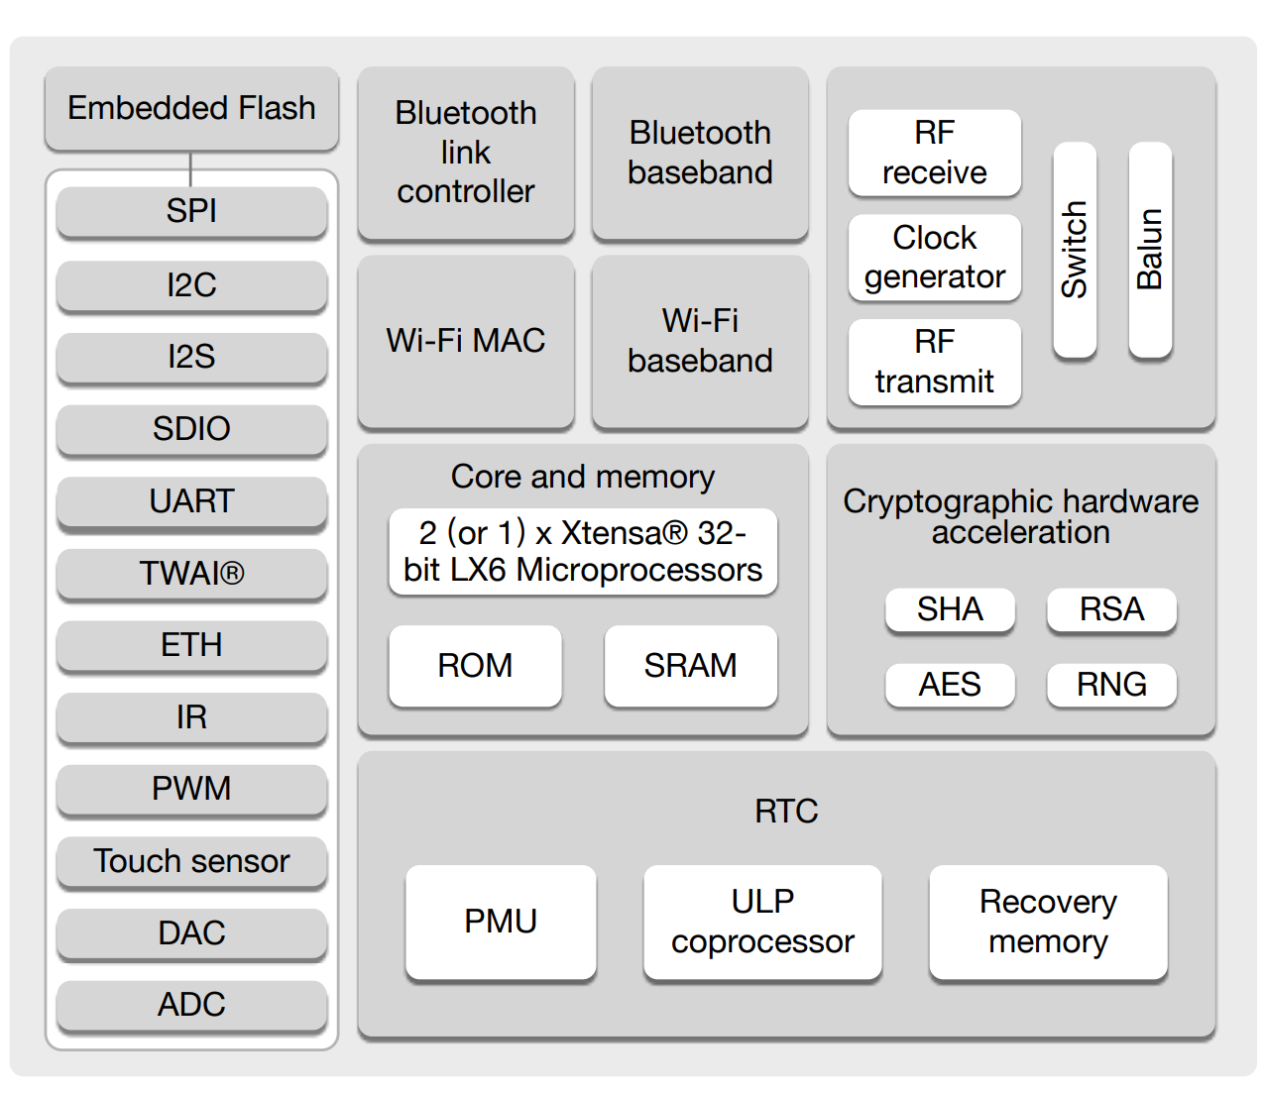
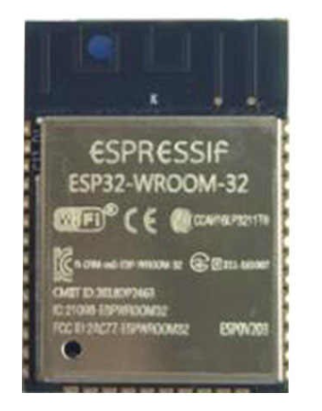
Microcontroller
Core component is an ESP32-WROOM32D
32-bit, dual-core 40 MHz
16MB flash storage
34 programmable GPIOS
2,4 GHz WiFi
Bluetooth, Bluetooth low energy
Programming languages
C (ESP-IDF)
C++ (Arduino IDE)
Micropython
Data sheet: https://www.espressif.com/sites/default/files/documentation/esp32-wroom-32d_esp32-wroom-32u_datasheet_en.pdf

Slide 5
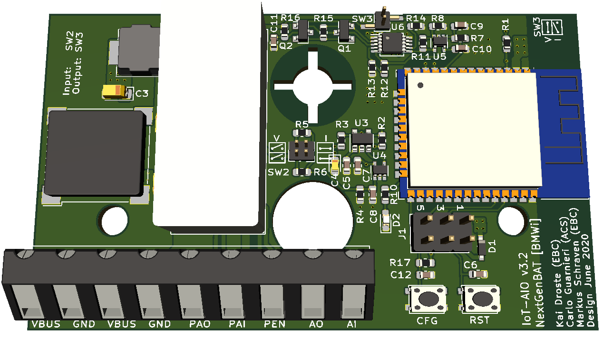
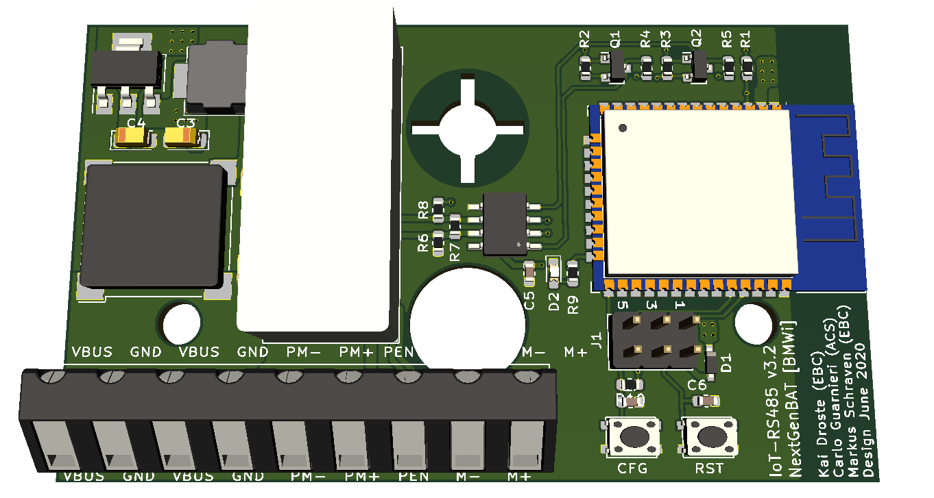
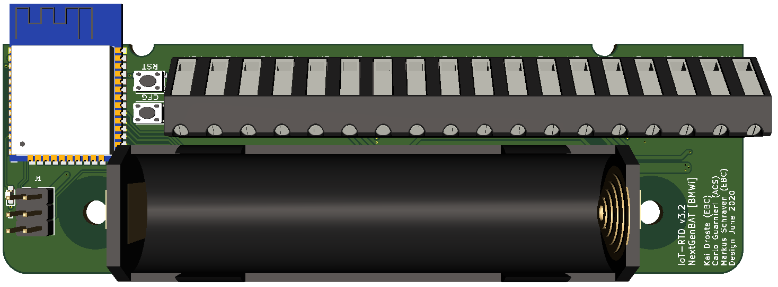
Gateway overview
45x120x17 mm
45x75x20 mm
45x75x20 mm
Analog
0(2) – 10 V
0(4) – 20 mA
1x Input, 1x Output (single-ended)
MCP3021, XTR111
Digital
RS485
Modbus RTU
(BACnet MS/TP, not yet implemented)
Communication with one field device (Software)
MAX13487
Temperature
RTD-probe
2,3,4 wires
Optional Battery operated (LiFePO4, 18650 cells)
24 VDC add-on supply
2 RTD-probes
MAX31865
Price: 36,07 €/pcs. 31,67 €/pcs. 53,32 €/pcs.
Notes:
Das Platinen Layout wurde anhand eines Lastenheftes erstellt
Kommunizieren über WLAN mit der Cloud

Slide 6
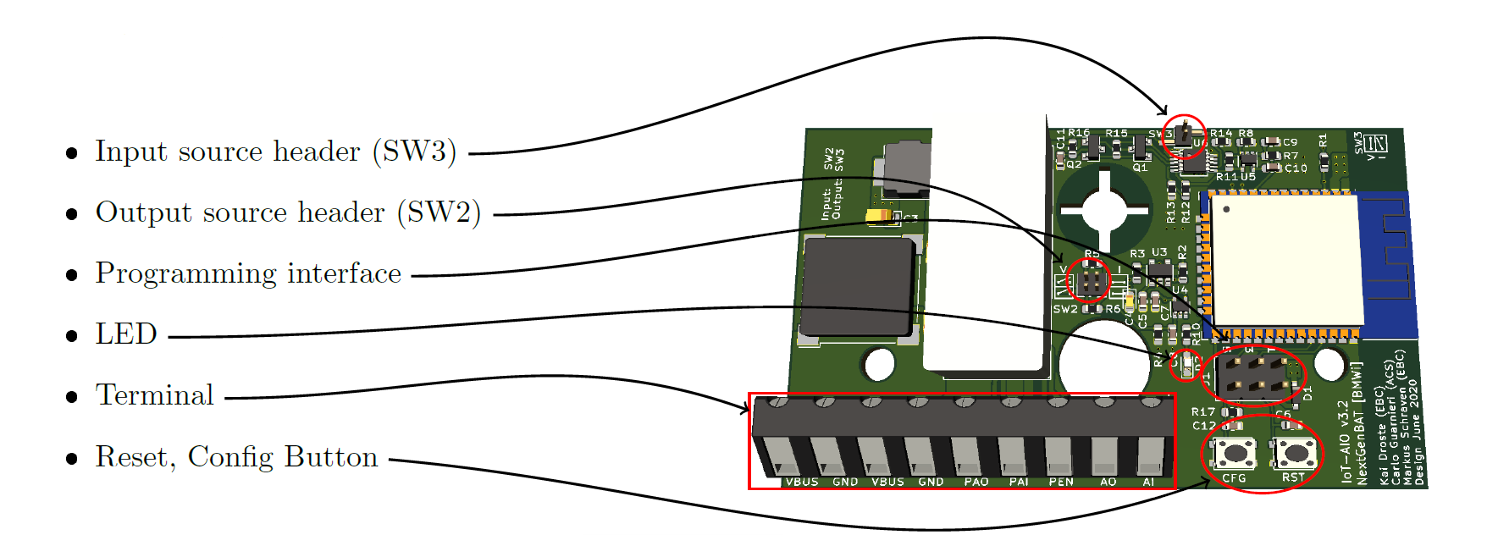
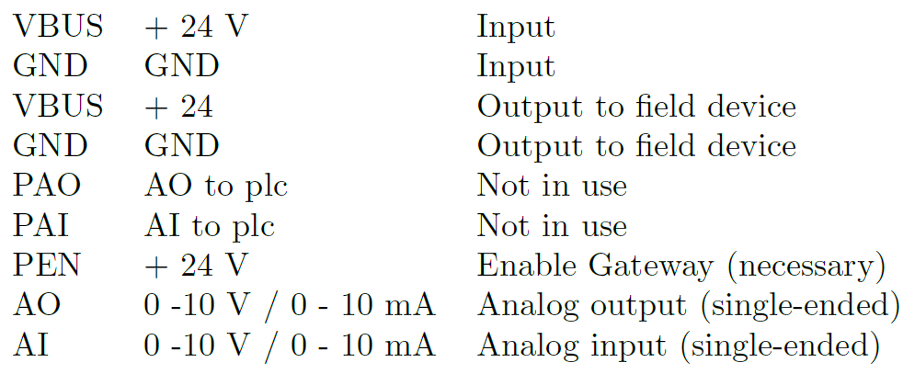
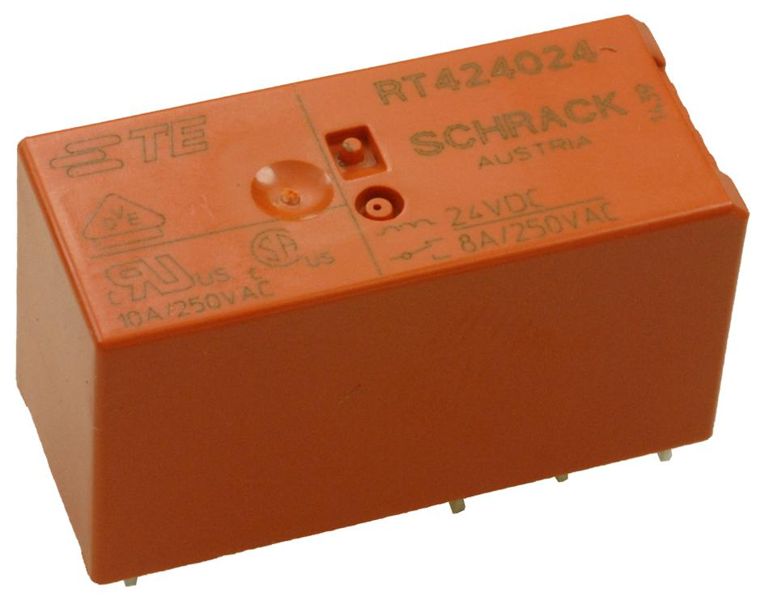
Analog Gateway
Pins labeled with „Not in use“ are used for the switching mechanism. More details can be found in chapter 2 of the instruction manual or slide 16 in this presentation.
Relay
Switching between internal and external signal path (“to PLC”), compare slide 16

Slide 7
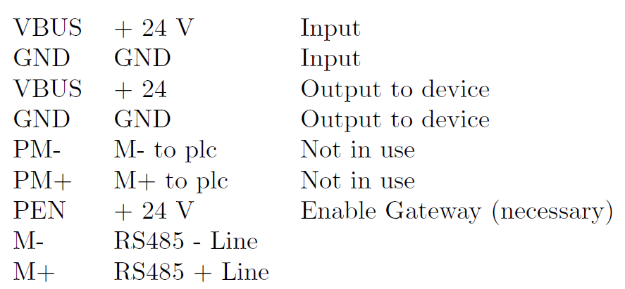
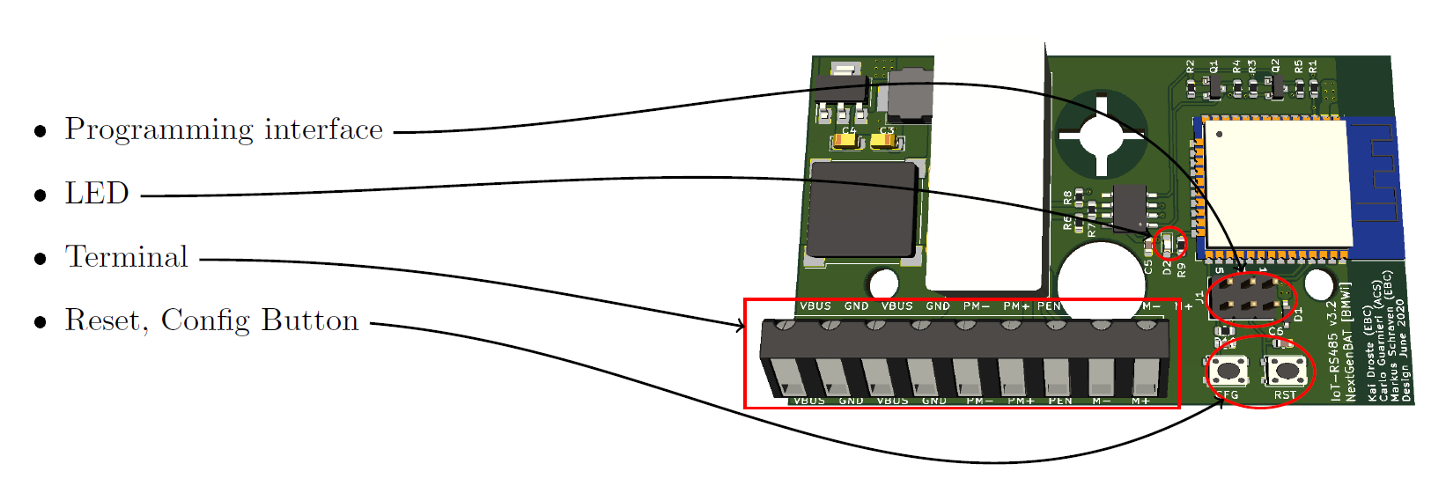
Digital Gateway
Pins labeled with „Not in use“ are used for the switching mechanism. More details can be found in chapter 2 of the instruction manual or slide 16 in this presentation.

Slide 8
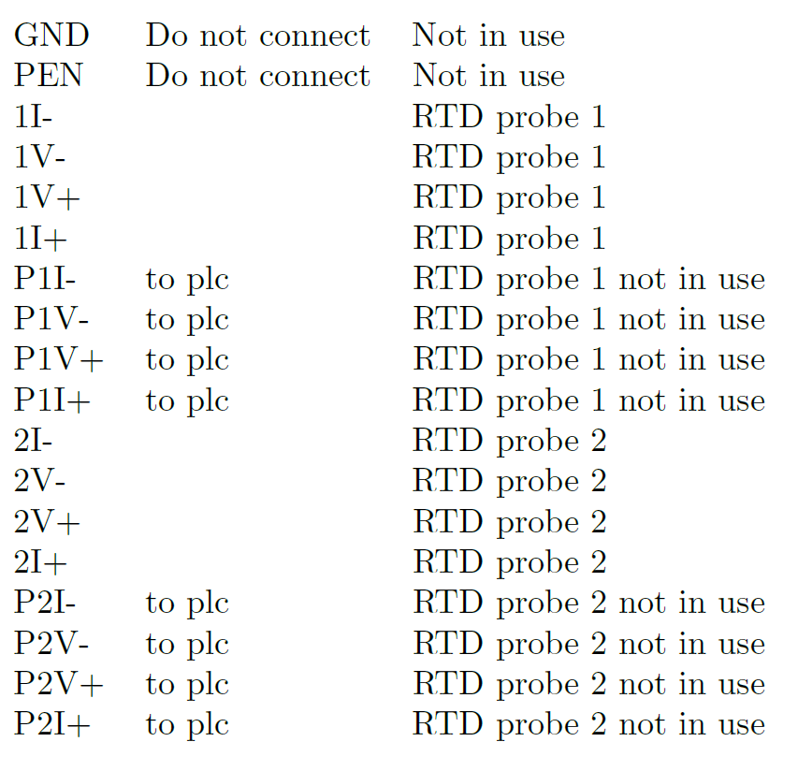
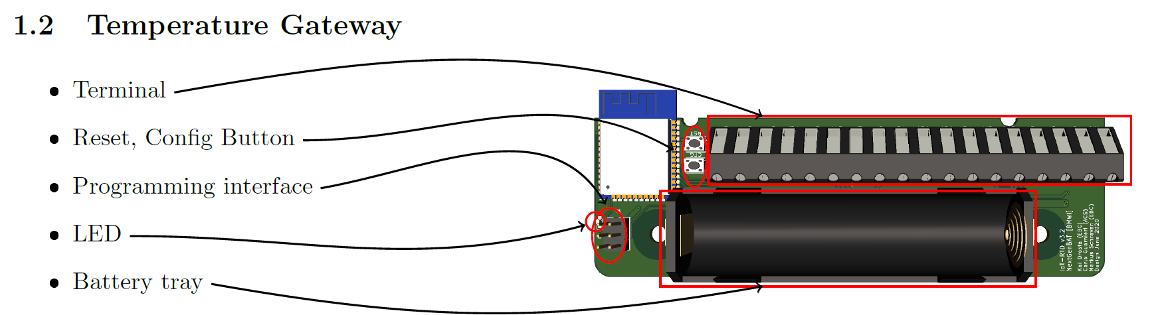
Temperature Gateway
Pins labeled with „Not in use“ are used for the switching mechanism. More details can be found in chapter 2 of the instruction manual or slide 16 in this presentation.

Slide 9

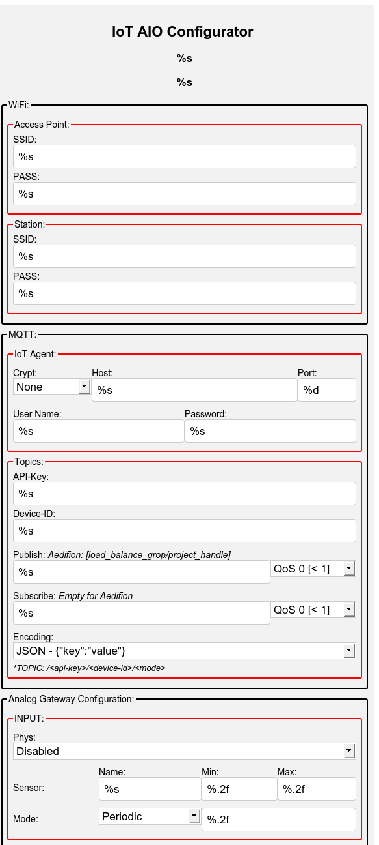
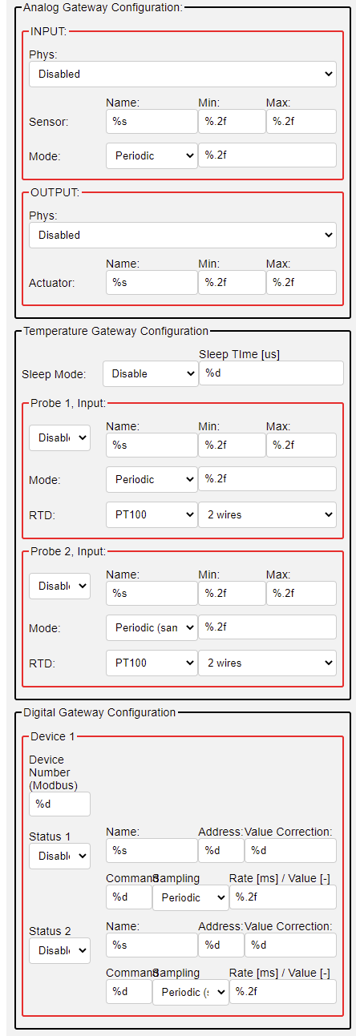
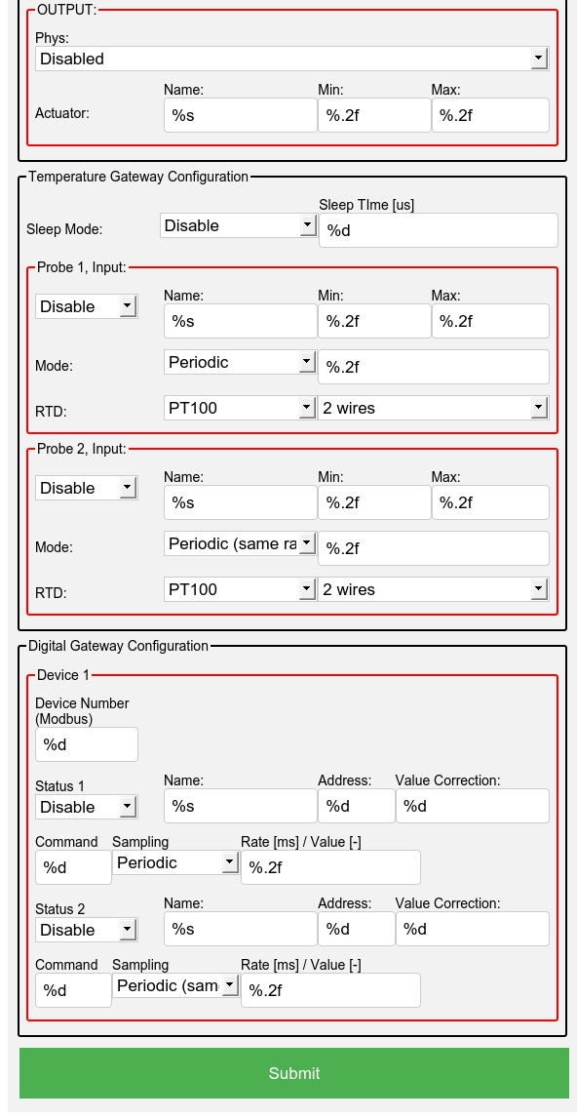
Configuration interface
Web server is accessed via the IP address of the gateway, see slide 13
The IP address can be discovered using a BLE beacon
Configuration exclusively via web server
file:///C:/git/iotdevelopment/software/software.c/doc/aio_configurator_request.html
https://git-ce.rwth-aachen.de/ebc/projects/ebc0449_bmwi_nextgenbat_ga/iot-development/iot-development.software/iot-development.software.c/-/blob/master/doc/aio_configurator_request.html
Web server for configuration
Keine Programmierkenntnisse notwendig
Aufrufen des Webservers über Tastendruck am Gateway
Over-the-Air (OTA) Updates
Notes:
Konfiguration über Webserver
Keine Programmierkenntnisse notwendig
Aufrufen des Webservers über Tastendruck am Gateway
Over-the-Air (OTA) Updates

Slide 10
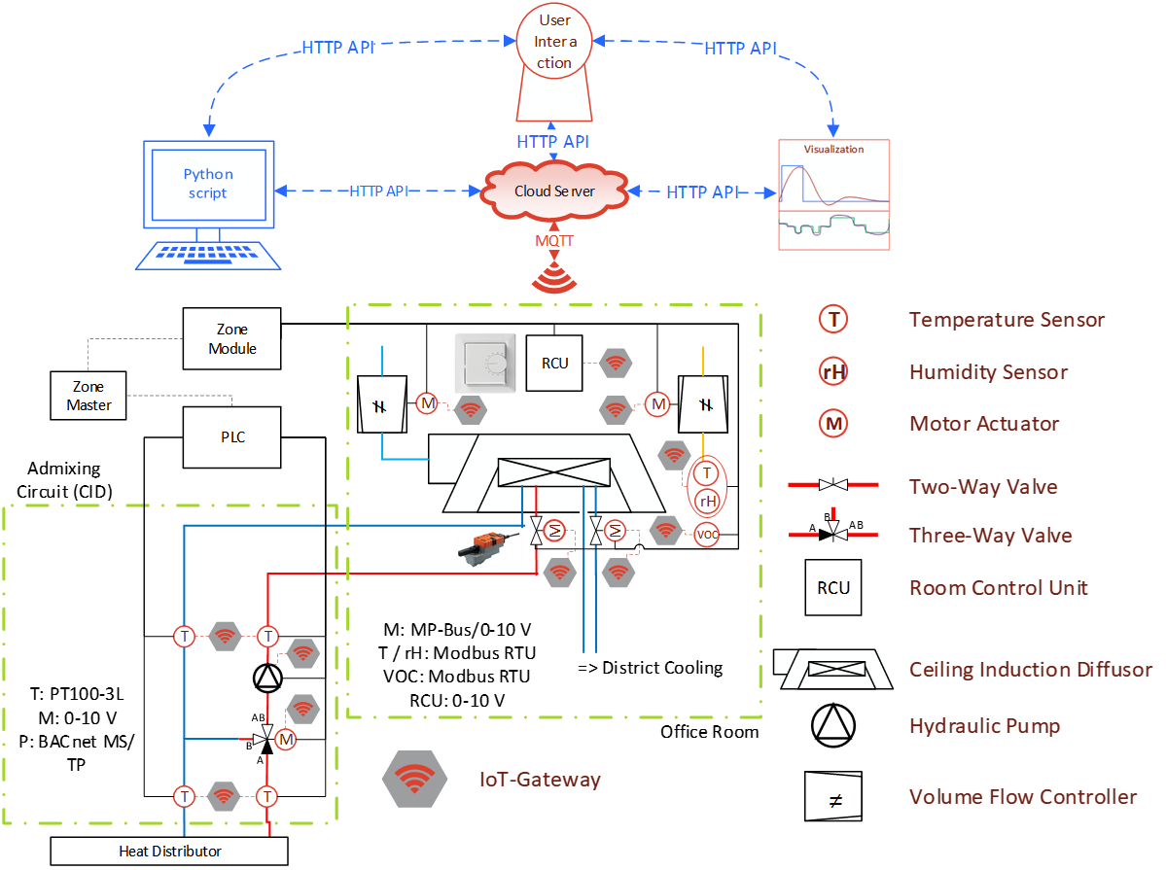
Example application
Notes:
Es wurden zwei repräsentative Systeme mit den Gateways ausgestattet
BIM (Building Information Modelling) – Modell von der Versuchshalle
Hier können die Lüftungs- und Heizungsleitungen gesehen werden

Slide 11
Further available information and repositories
Firmware (Programmed in C using ESP-IDF)
EBC / projects / EBC0449_BMWi_NextGenBAT_GA / iot-development / iot-development.software / iot-development.software.C · GitLab (rwth-aachen.de)
See documentation in readme and Wiki
Hardware (PCB design in KiCAD)
iot-development.hardware.iotgate_v3 · GitLab (rwth-aachen.de)
Instructions manual
EBC / projects / EBC0449_BMWi_NextGenBAT_GA / iot-development / iot-development.dissemination / IoT-Gateway-Documentation · GitLab (rwth-aachen.de)

Slide 12
Operators instructions I - Configuration

Slide 13
Accessing the web server interface
Requirements: Firmware is already flashed, see operators instructions II (slides 26 onwards)
In delivery state, the gateway is not able to connect to a WiFi network, directly
First, the CFG button has to be pressed between 1 s and 3 s to initialize the access point interface
The AP will be displayed as ESPxxxx in the available WiFi connections (AP mode)
The gateway sets up an individual network. The default password is 123456789
Connect to the WiFi AP with an end device of your choice (e. g. computer, smartphone, etc.)
The web server interface can be accessed with a web browser and the IP address 192.168.4.1
When already connected to a WiFi network
The web interface is now accessed via the IP of the gateway
For finding the IP, you can, for instance:
Use BLE beacon => Press CFG button for < 1 s: LED blinks 2x
The IP address is provided as BLE-Beacon, which can be received with a Bluetooth-enabled device. e. g.:
Bluetooth Beacon Interactor (Windows Store)
eBeacon (IOS)
Alternatively, checking IP in router config (might be incomprehensible with many gateways in the network)

Slide 14
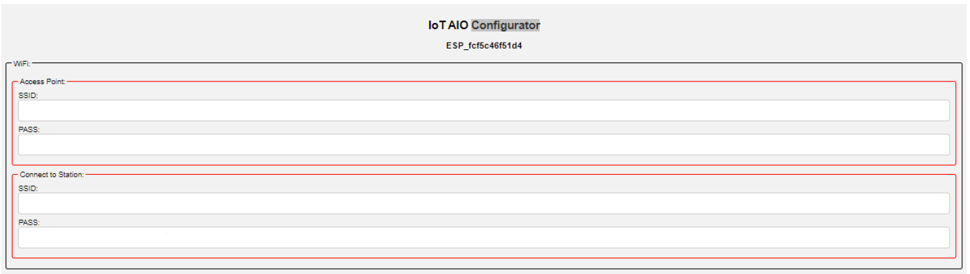
WiFi configuration
Access Point
Set name and password for the AP of the Gateway (e. g. credentials when activating the AP configuration)
Should usually not be touched, as the gateway will most likely be operated connected to a network. Default credentials are SSID=MAC address of the ESP, and PW=12345679
Station
SSID and password of the WiFi network the Gateway should be connected to.
Note that it might not be possible to connect with special encrypted networks like WPA2 enterprise (Eduroam)

Slide 15
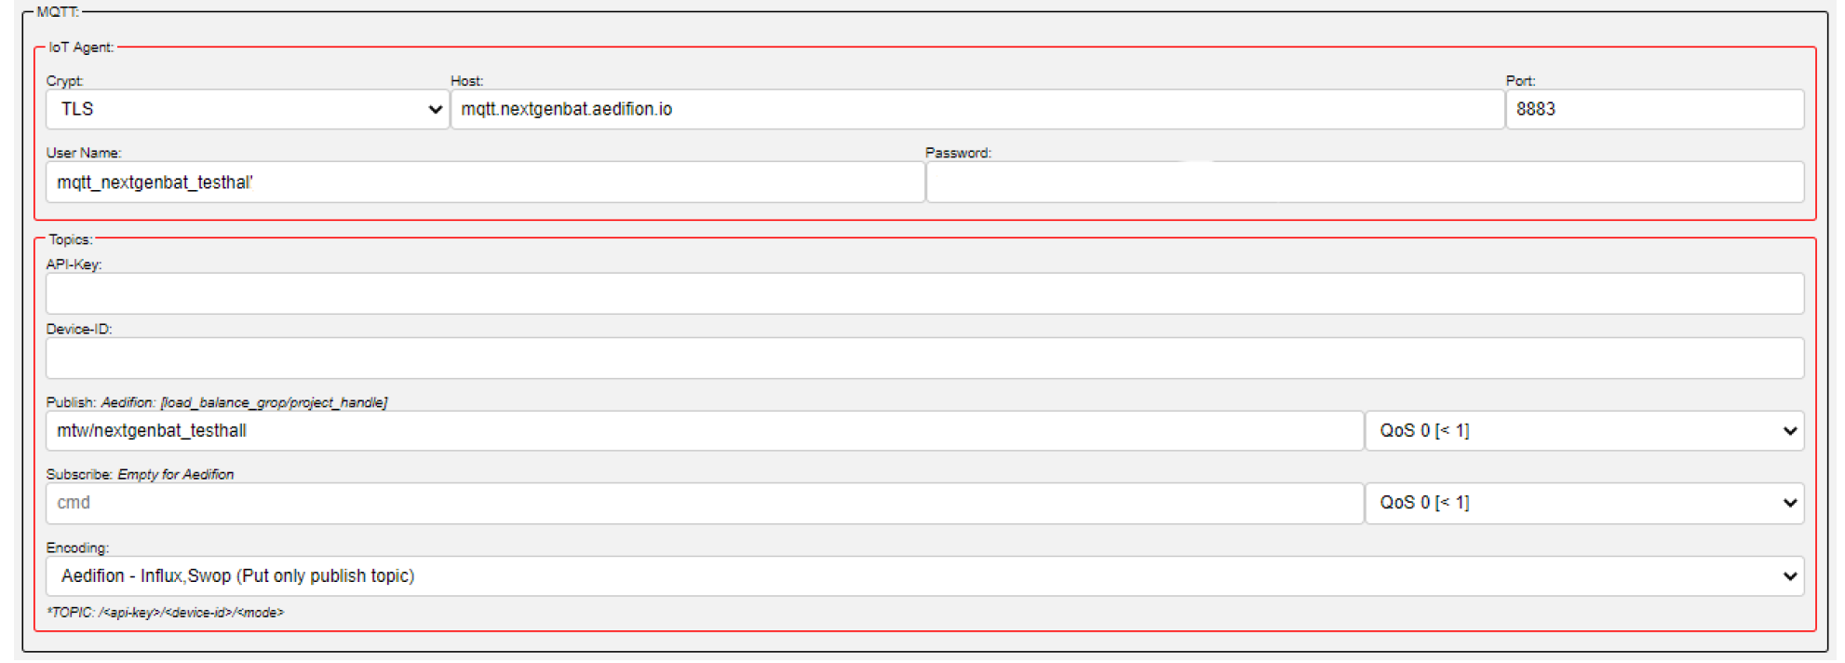
MQTT configuration
Supports JSON and special encoding for aedifion and FIWARE platform
A detailled manual is located in this same repository:
EBC / projects / EBC0449_BMWi_NextGenBAT_GA / iot-development / iot-development.dissemination / IoT-Gateway-Documentation · GitLab (rwth-aachen.de)

Slide 16
Switching between SotA and IoT mode
24 VDC
Notes:
Vergleich im realen Betrieb

Slide 17
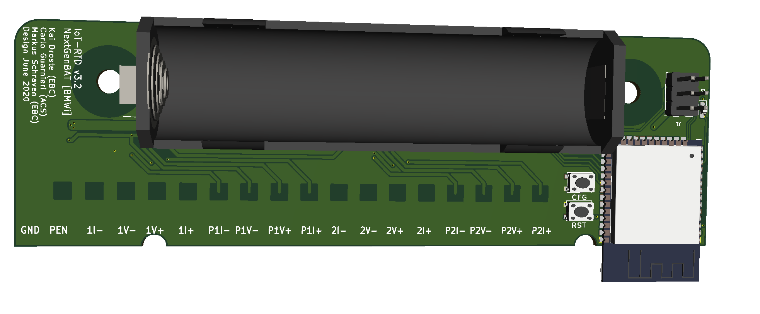
Switching between SotA and IoT mode: Special considerations
Analog / Digital Gateway
If PEN = GND → AO, AI are connected to PAO und PAI (hence, no internal processing by the Gateway)
Switching is achieved via 24 VDC signal on PEN terminal, e. g. with a jumper to VBUS, compare slide 6 onwards
Switching relais(RT424024): DDEController (te.com)
Temperature Gateway
GND and PEN (24 VDC) must be connected for an internal processing, without the 24 VDC signal on PEN, the input terminals (I+-,V+-) are directly connected with the output terminals (PI+-,PV+-).
Switching multiplexer(TS3A44159): TS3A44159 0.45-Ω Quad SPDT Analog Switch 4-Channel 2:1 Multiplexer – Demultiplexer With Two Controls datasheet (Rev. B)
The Gateway requires a permanent power supply even if signals are only forwarded to the external system!

Slide 18
Hardware configuration: Analog Gateway - Switching voltage and current signal mode
3x2 pin header jumper required
SW2: Output signal mode, requires 2 jumpers
SW3: Input signal mode, requires 1 jumper
SW2: Output
Voltage mode: no jumpers attached
Current mode: both jumpers attached
SW3: Input
Voltage mode: jumper attached
Current mode: no jumper attached

Slide 19
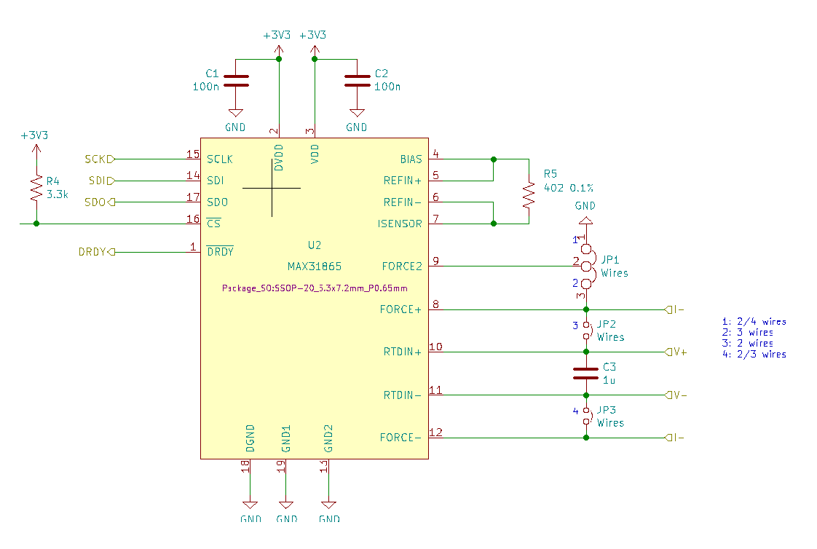
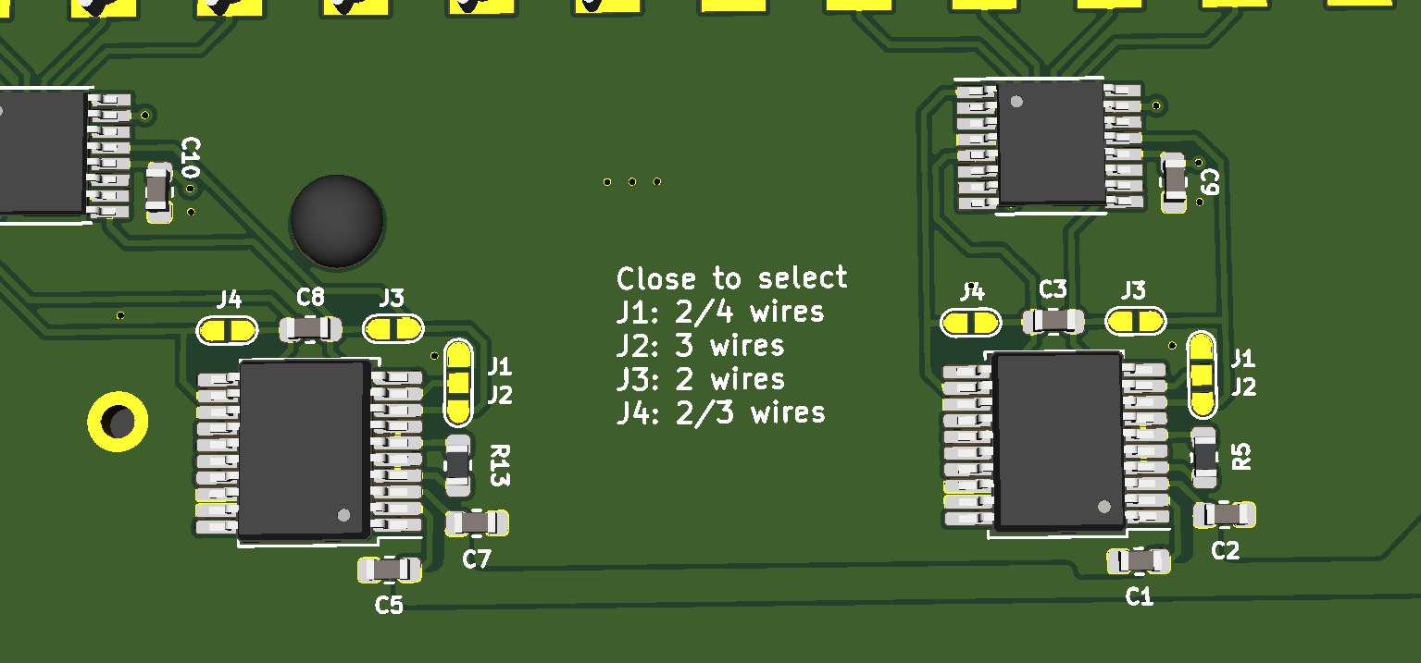
Hardware configuration: Temperature GW I - Connecting the RTD element
Connecting 2-, 3-, 4-wire RTD elements
The MAX31865 (IC for the temperature measurement) has to be configured by soldering connections (J1-J4)
Terminal pin connections:
For a 2-wire probe, connect V+ and V-
For a 3-wire probe, connect I+, V+ and V-
For a 4-wire probe, connect all four pins I+, V+, I- and V-
Datenblatt MAX31865: MAX31865.pdf (maximintegrated.com)

Slide 20
Hardware configuration: Temperature GW II - Adjusting the RTD type/reference resistor
In order to connect a different type than a PT100 probe, e. g. a PT1000, the reference resistors R13 for channel 1 and R5 for channel 2 (see slide 19) have to be exchanged (soldering required).
The resistor should amount to 4 time the nominal value, e. g.
PT100 requires a 400 Ω resistor
PT1000 requires a 4 kΩ resistor
Additionally, in the configuration (web interface), the type/reference needs to be adjusted
PT1000 is implemented as additional choice in the drop-down menu, different resistors require software adjustments
Datenblatt MAX31865: MAX31865.pdf (maximintegrated.com)

Slide 21
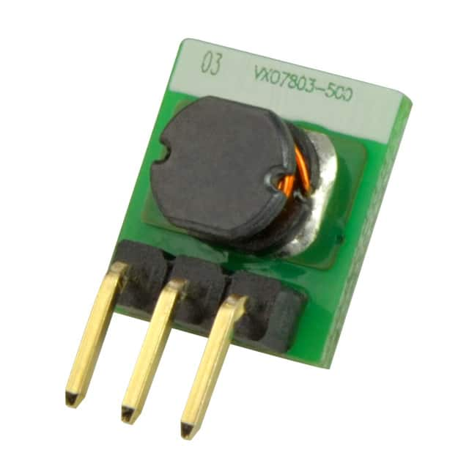
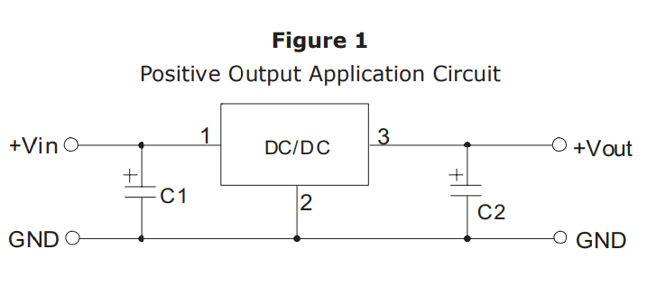
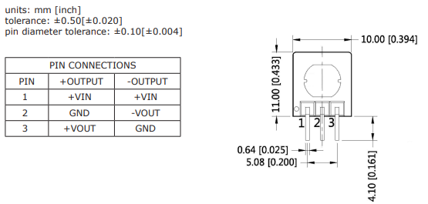
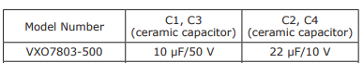
Hardware configuration: Temperature GW III - 24 VDC power supply
Originally, the temperature Gateways have been designed for battery operation
While this seems practical, the fully charged battery (1000 mAh) lasted merly roughly 2 weeks significantly reducing the practical benefits
In order to allow 24 VDC supply (same as the other Gateways) a Buck-Converter can be used (transforming 24 VDC to 3.3 VDC)
E. g. Buck-Converter: VXO7803-500 VXO78-500 Series Datasheet - Non-Isolated | CUI Inc
The Buck-Converter can be soldered directly to the positive and negative pole of the battery tray

Slide 22
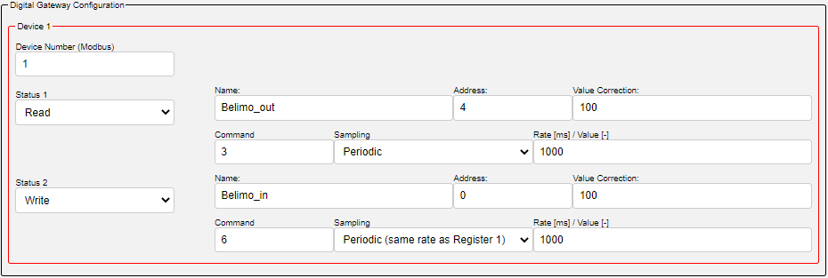
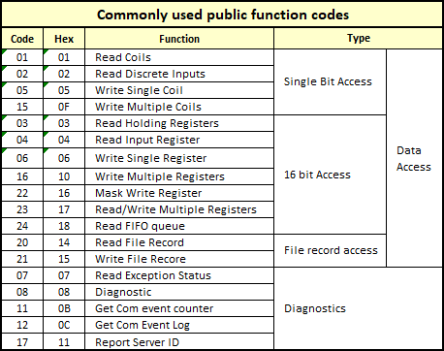
Software configuration: Digital GW I - Configuration of Modbus coils and registers
Typical function codes
Device Number:
Device ID: Device address within the bus
Status (read & write holding registers)
Read
Write
Register (function code)
E.g. 3: Read holding register or 6: write single register
See table on the right
Address:
Register address to be read or written

Slide 23
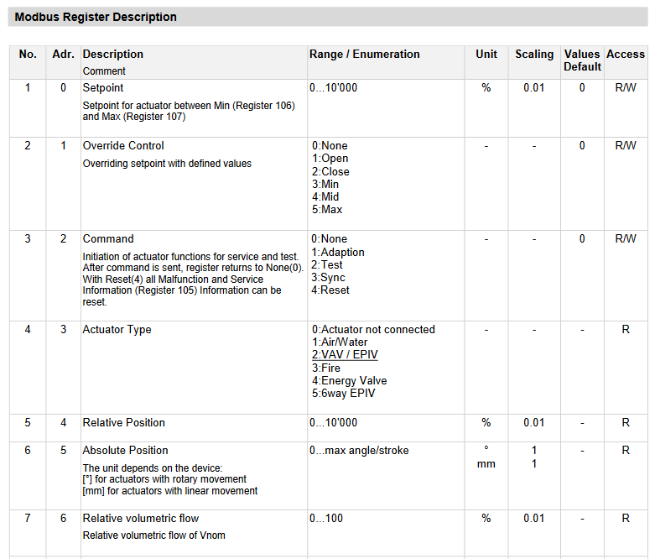
Software configuration: Digital GW II - Configuration of Modbus coils and registers
Example Modbus register for a volume flow control actuator
Typical function codes

Slide 24
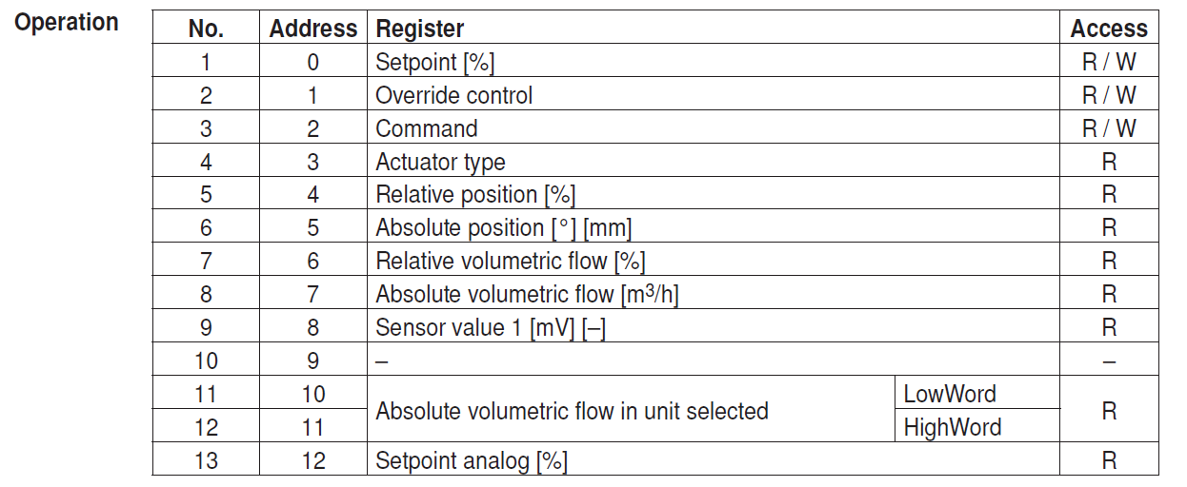
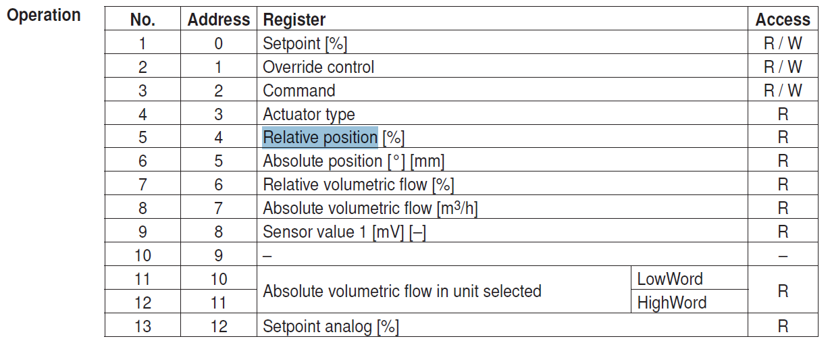
Software configuration: Digital GW III - Configuration of Modbus coils and registers - Example
Example configuration of a Belimo LM24A-MOD
Belimo Modbus registers

Slide 25
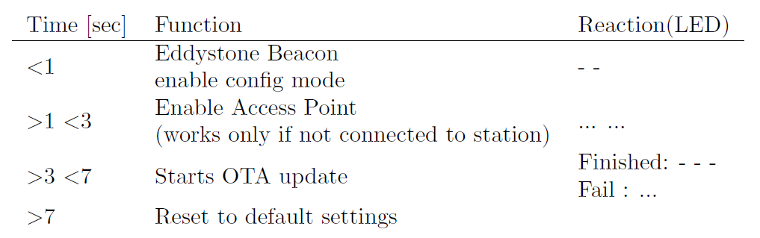
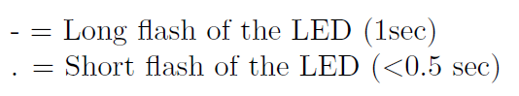
Functionalities implemented to the CFG button

Slide 26
Operators instructions II - Inital setup / Flashing the firmware

Slide 27
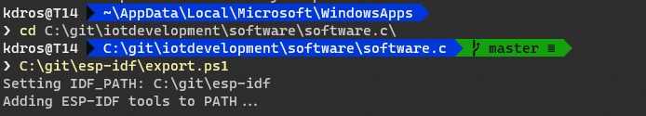
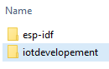
Operators instructions II - Initial setup / Flashing the firmware - Menuconfig
Disclaimer: All commands shown here are executed in Windows Powershell or Windows Terminal
For the firmware to be flashed, it has to be compiled first on your computer
Start a terminal (CMD/PowerShell)
cd into the repository of the Gateway software
Start the ESP-IDF
This obviously requires the ESP-IDF to be installed and configured
For further information on installing and configuring the ESP-IDF, see https://docs.espressif.com/projects/esp-idf/en/latest/esp32/get-started/index.html
https://docs.espressif.com/projects/esp-idf/en/latest/esp32s2/get-started/#step-4-set-up-the-environment-variables
Alternatively, one can use the preconfigured terminal from the ESP-IDF and navigate into the repository from there

Slide 28
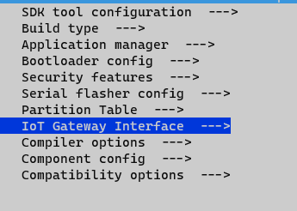
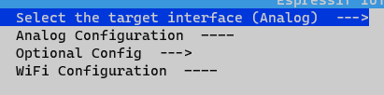
Operators instructions II - Initial setup / Flashing the firmware - Menuconfig
Disclaimer: All commands shown here are executed in Windows Powershell or Windows Terminal
For practicality, the repository already contains 3 different configurations (analog, temperature, digital)
sdkconfig.aio
sdkconfig.tmp
sdkconfig.dio
To choose a configuration, copy and rename one of them to sdkconfig
Subsequently, the configuration should be validated in the menuconfig
Leave the menuconfig hitting the ESC key
In this example, the analog configuration has been copied → the menuconfig shows „analog“ as selected interface → configuration is correct The menu can be closed hitting the ESC key

Slide 29
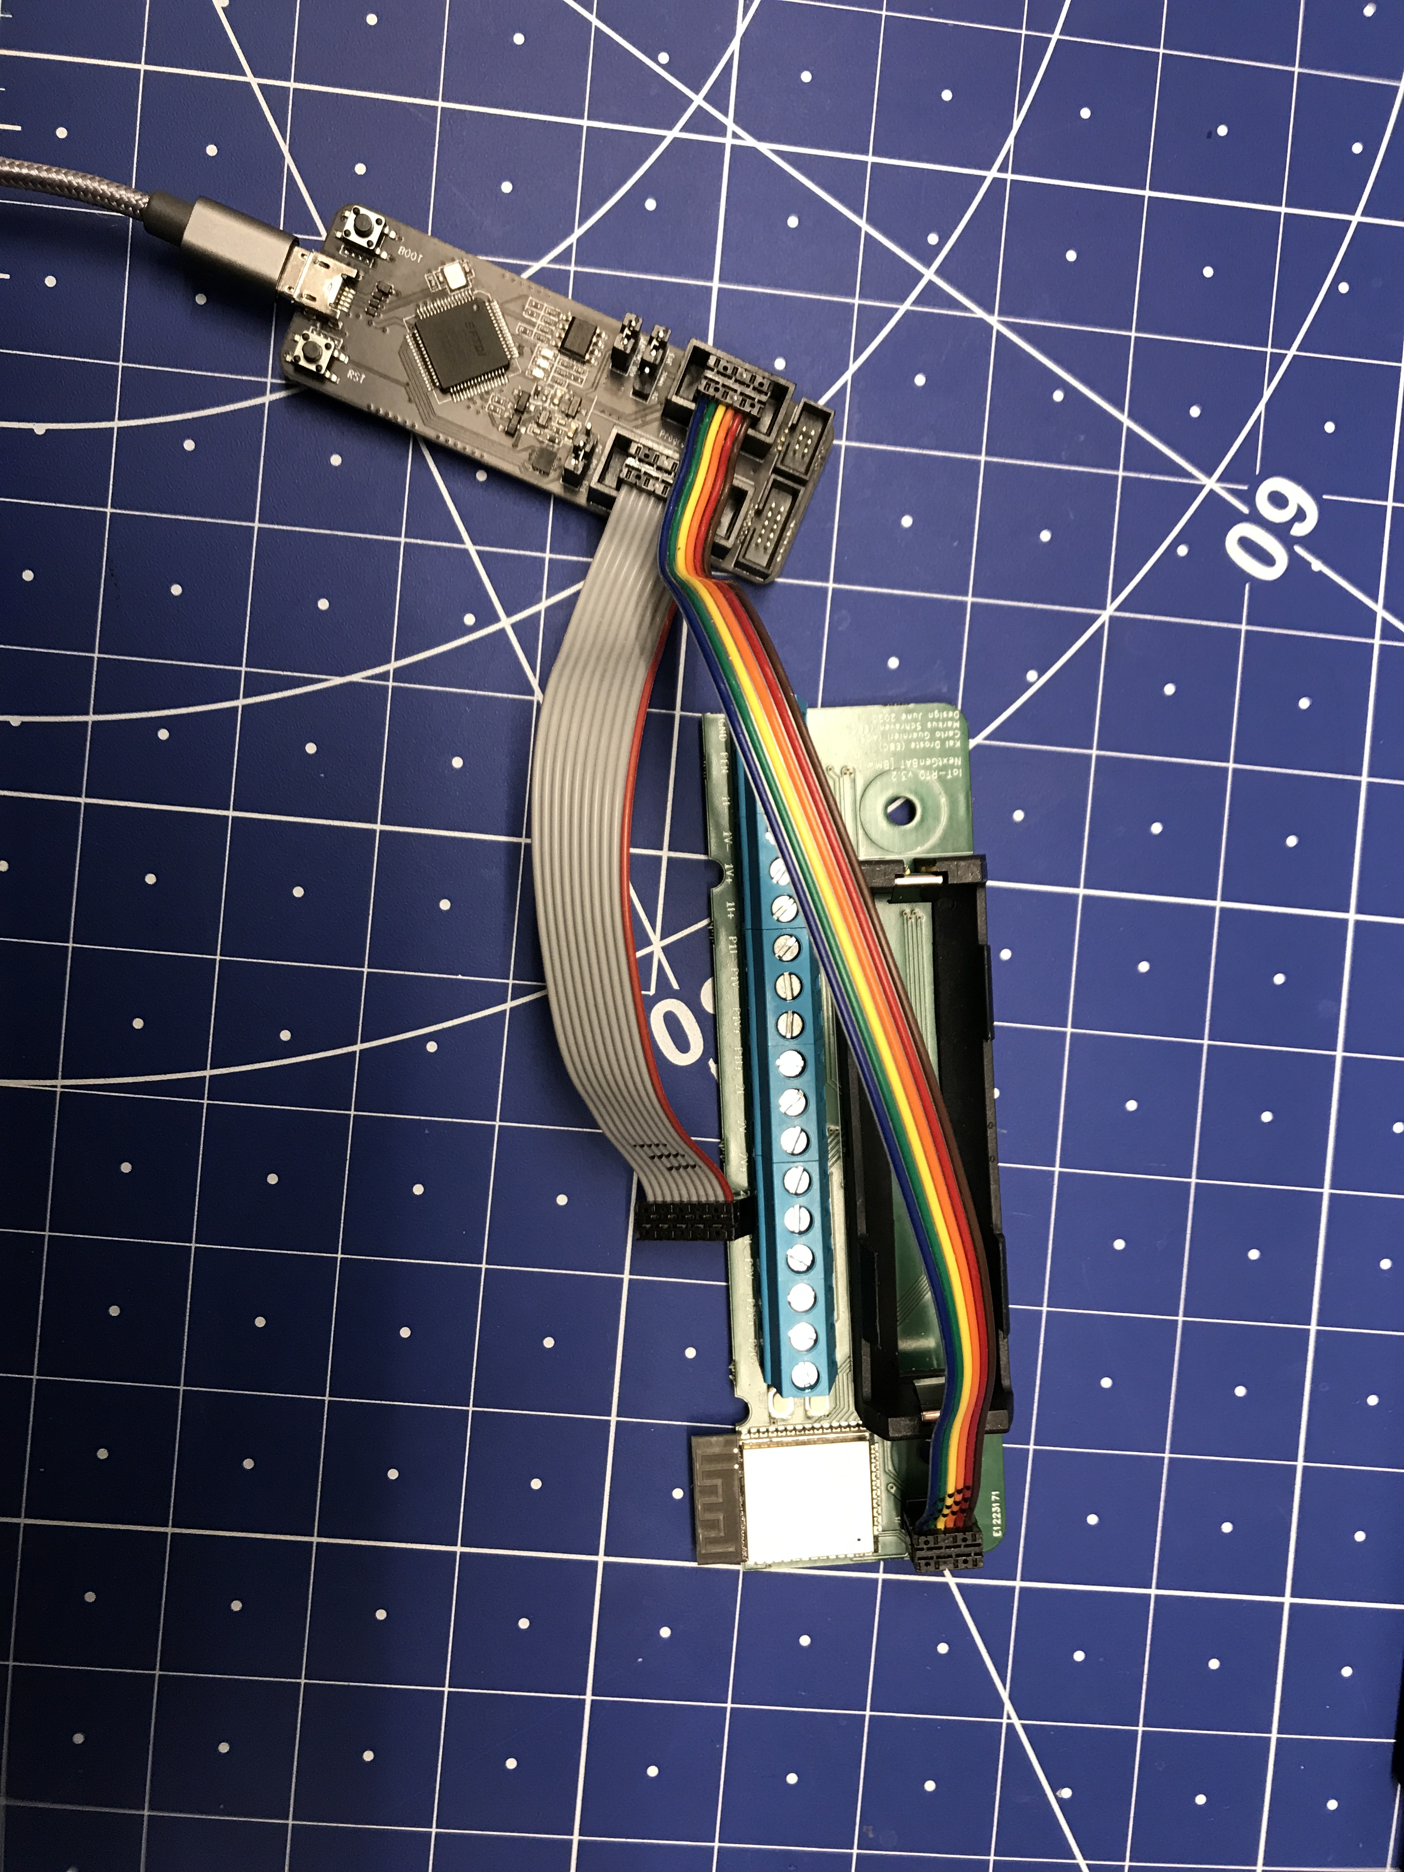
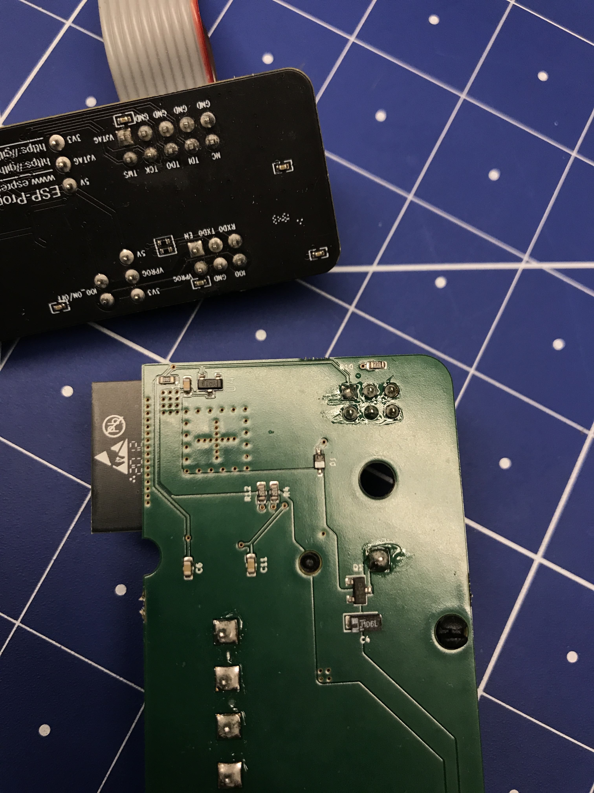
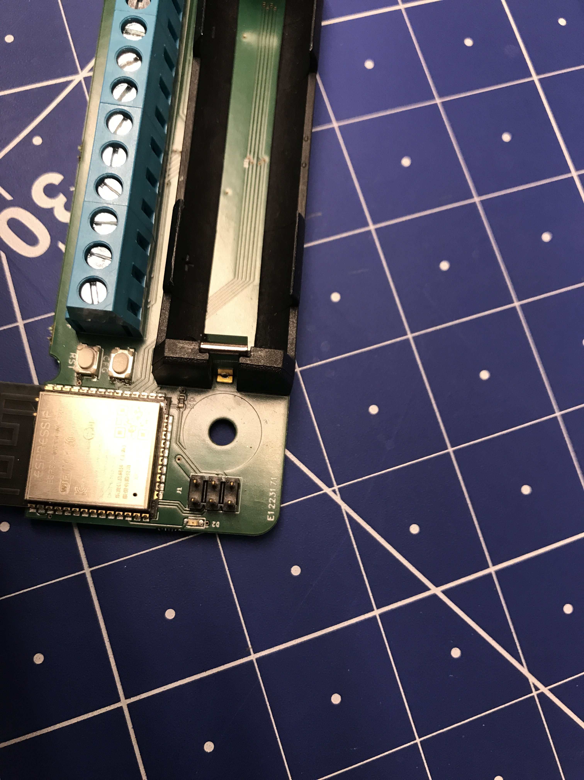
Operators instructions II - Initial setup / Flashing the firmware - Build / Connecting the programmer
Disclaimer: All commands shown here are executed in Windows Powershell or Windows Terminal
The firmware can now be compiled with the selected configuration
idf.py build
Programmer
6-pole cable → used for flashing the firmware
8-pole cable → JTAG (can be used for an inline debugging of the ESP)
The 6-pole cable has to be connected in a way, that it matches the Pin assignement on the Gateway!
E. g., compare the PCB solder point: The squared solder point marks PIN 1 on each device
From top perspective, PIN 1 is observed by an interruption of the white frame
PIN 1

Slide 30
Operators instructions II - Initial setup / Flashing the firmware - Flash, Monitor
Disclaimer: All commands shown here are executed in Windows Powershell or Windows Terminal
Flashing the firmware to the Gateway
idf.py flash
Serial monitor (for debugging and checking the version/firmware)
idf.py monitor
Basically a command line printing info, debug and error messages
The debug level can be adjusted in ?
Might be necessary to specify the port by adding –p com6 (e. g. for serial port COM6)
Commands can be combined / executed one after the other in one command (flash also incorporates the build command)
E. g., idf.py flash monitor
Or idf.py menuconfig flash monitor

Slide 31
Developers instructions - Development / Adjusting the firmware

Slide 32
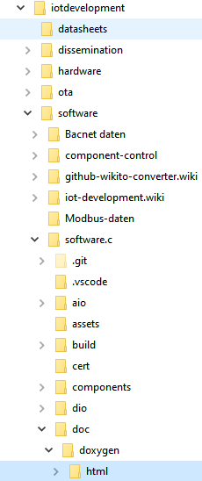
Developers instructions - Development / Adjusting the firmware
The header files (*.h) are, for the most part, commented within the code
From these, a Doxygen documentation has been created
It is accessed via the index.html in /doc/doxygen/html/
In VSCode, you can access the related header file to a function by marking the function and pressing F12
This may help to better understand the origin and operating principle of the selected function
For adding new variables that are coupled to the configuration (web interface), please consider the steps documented at doc/markdown/aio_configurator.md · master · EBC / projects / EBC0449_BMWi_NextGenBAT_GA / iot-development / iot-development.software / iot-development.software.C · GitLab (rwth-aachen.de)
The process is quite tedious (currently requires multiple conversions and a specific order) and will be revised in future development

Slide 33
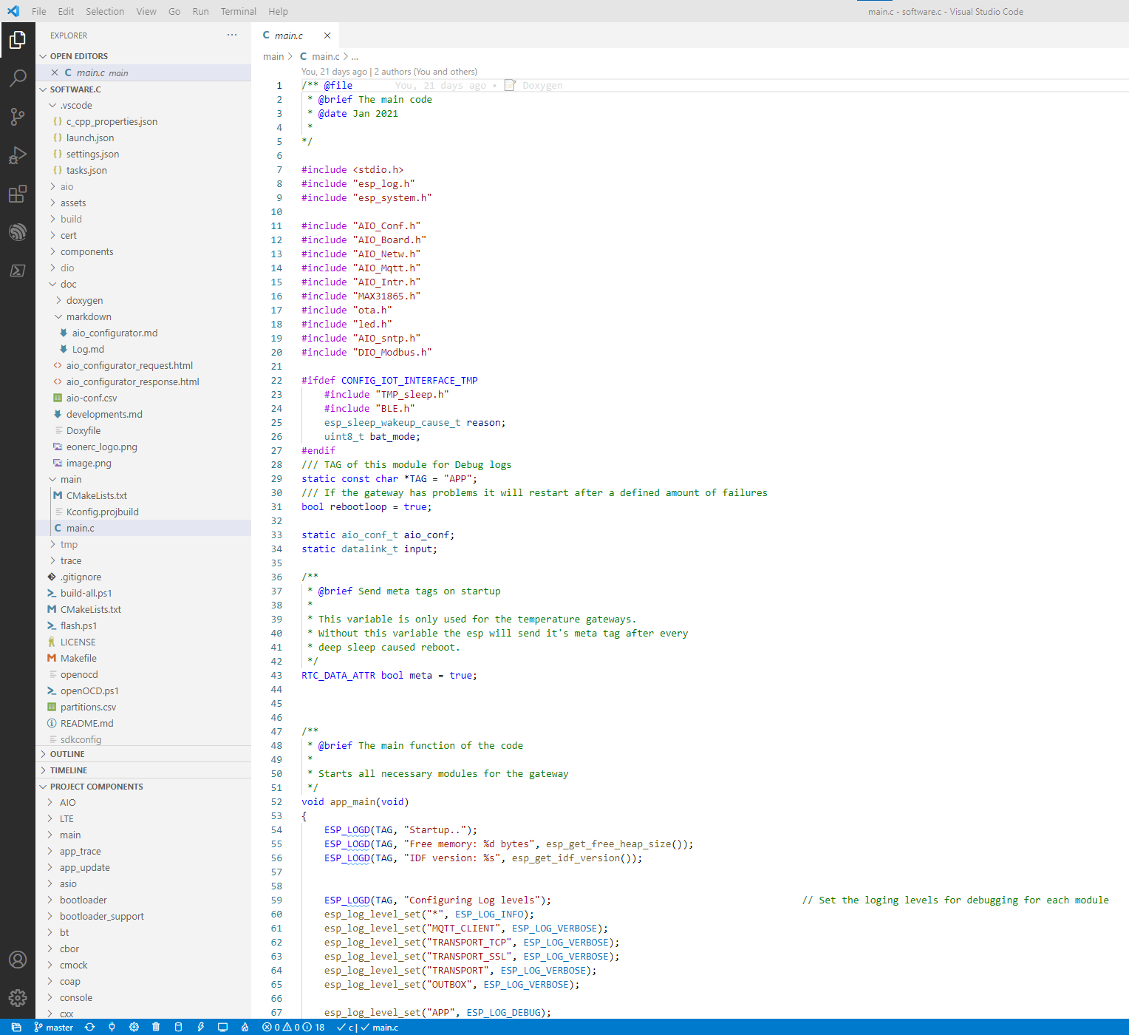
VSCode
If you are in a terminal (powershell), VSCode can be started entering „code .“ (will be executed in the current working directory / same directory as the terminal)
VSCode overview:
File explorer
Git integration
Current branch
ESP-IDF integration
VSCode integrated ESP-IDF tasks (e. g. flash, build, …)
This feature requires the ESP-IDF AddOn to be installed to VSCode
Main application main.c
GW interface-related code in components
The folders „aio“, „dio“, „tmp“, „build“ contain compiled files
They are generated by idf.build

Slide 34
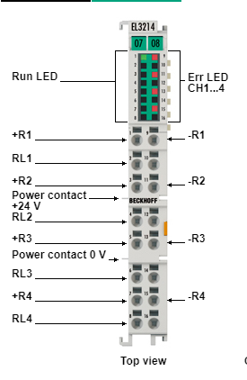
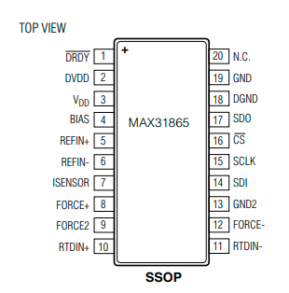
Measurement Accuracy I
Max31865 RTD to digital converter
15 Bit ADC resolution
0.03125 °C
→ 0.5 °C
21ms (max) conversion Time
EL3214 | 4-channel input terminal PT100 (RTD)
0.1 °C resolution
170 ms sampling rate
https://datasheets.maximintegrated.com/en/ds/MAX31865.pdf
https://www.beckhoff.de/default.asp?ethercat/el3214.htm
Notes:
For measuring temperatures, a MAX31865 [26] rtd to digital
converter is used.
This converter has a 15-Bit adc resolution
which means it has an accuracy of approximately
0.03125 °C.
According to its data sheet, the resolution varies
due to rtd non-linearity which results in a total resolution
over all operating conditions of 0.5 °C.

Slide 35
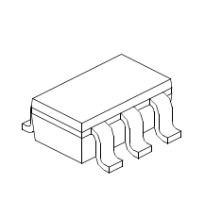
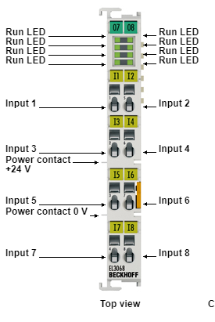
Measurement Accuracy II
MCP3021 analog to digital converter
10 Bit resolution
EL3068 | 8-channel analog input terminal 0…10 V
12 Bit resolution
https://eu.mouser.com/datasheet/2/268/21805a-74229.pdf
https://www.beckhoff.de/default.asp?ethercat/el3068.htm

Slide 36
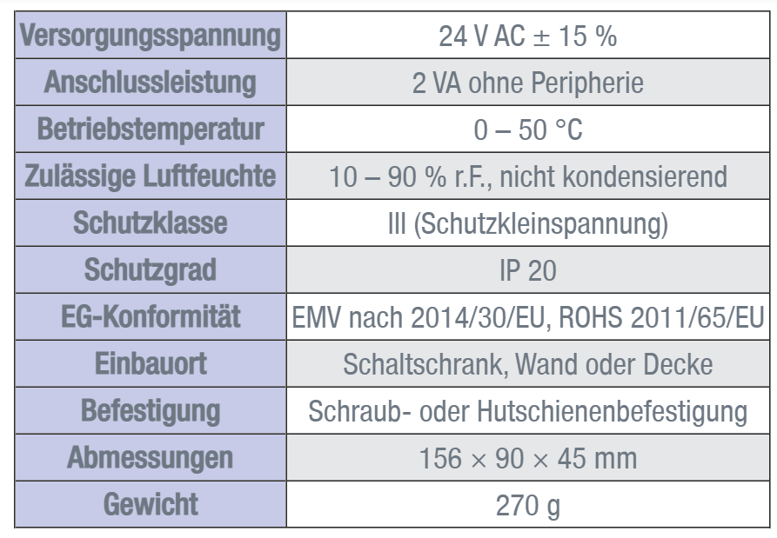
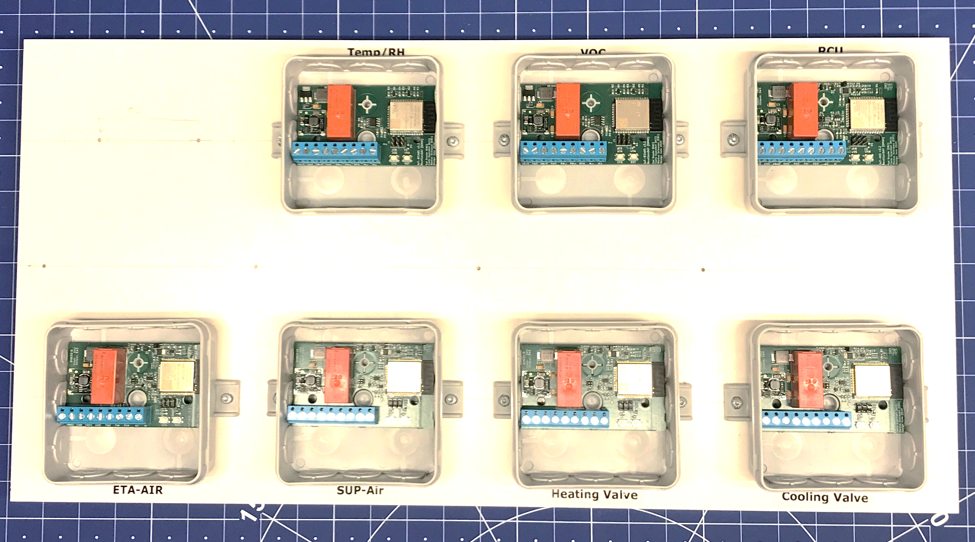
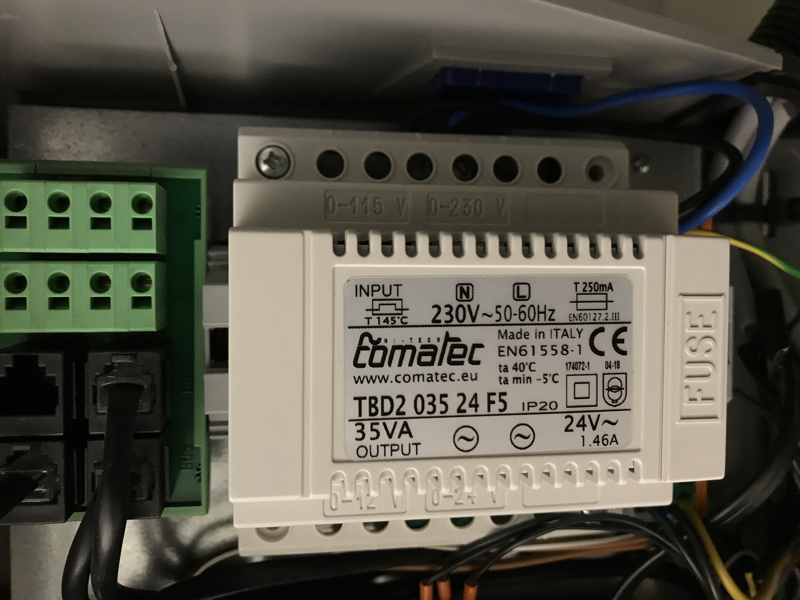
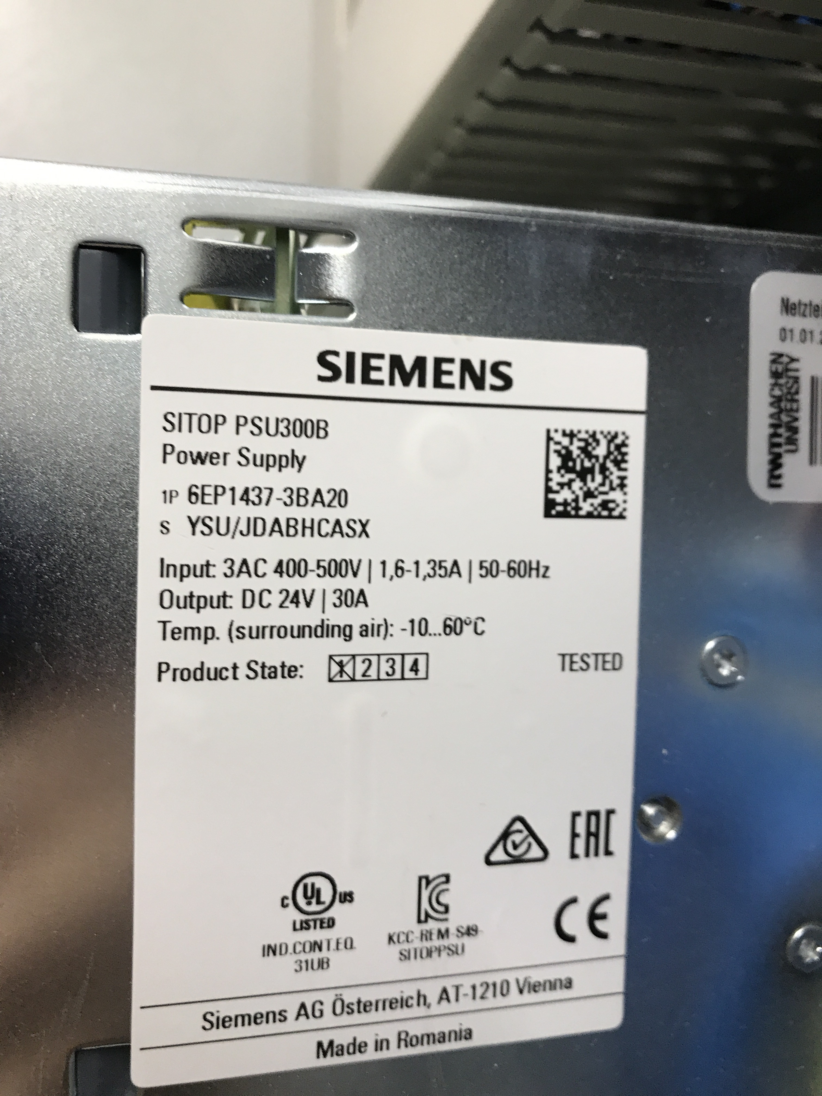
Power consumption
Digital GW
Standby 20 mA, 24 V, 0,48 W
Temp GW
Standby 10-20 mA, 24 V, 0,24-0,48 W
Analog GW
Standby 20 mA, 24 V, 0,48 W
https://www.trox.de/zonenmodule/x-air-zmo-f9b1738e5431ff98

Slide 37

Contact
E.ON Energy Research Center
Mathieustraße 10
52074 Aachen
Germany

